Slide 1


Burger Website
Mern Stack App
Internship Project Presentation
Name: ADUSUMILLI SATYA SAI VEERA MANIKANTA
ROLL_NO:121EC0765
DATE:16-06-2024

Slide 2
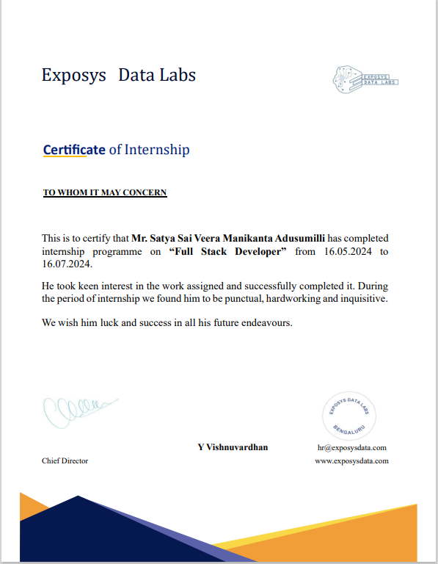

Slide 3
Introduction
:
Brief Overview of the Project:
The Burger Website Project is an online platform for ordering customized burgers. It supports three user roles with distinct functionalities:
Users: Customize burgers, manage carts, place orders, and view their own orders.
Employees: In addition to user capabilities, they can view all users orders, update delivery statuses of orders, and manage ingredients which are used for customizing burgers.
Administrators: Full access including burger management (create, update, delete) and user role management
Purpose of the Project:
The purpose of the Burger Website Project is to create a user-friendly online platform that enables customers to easily customize and order burgers. The project aims to streamline the ordering process, enhance customer satisfaction through customization options, and efficiently manage orders. Additionally, the platform provides employees and administrators with tools to manage orders, ingredients, and user roles, thereby improving operational efficiency and overall user experience.

Slide 4
Tech Stack Used
React.js
React-redux
React-Router
Node.js
MongoDB
Express.js

Slide 5
User Roles
Regular Users:
Customize burgers and manage their cart.
Place orders and view only their own order history.
Employees:
All user capabilities plus:
View and manage all orders.
Update delivery statuses.
Manage ingredients (add, update, delete).
Administrators:
All employee capabilities plus:
Create, update, and delete burger items.
Manage user roles (promote users to employees and vice versa).

Slide 6
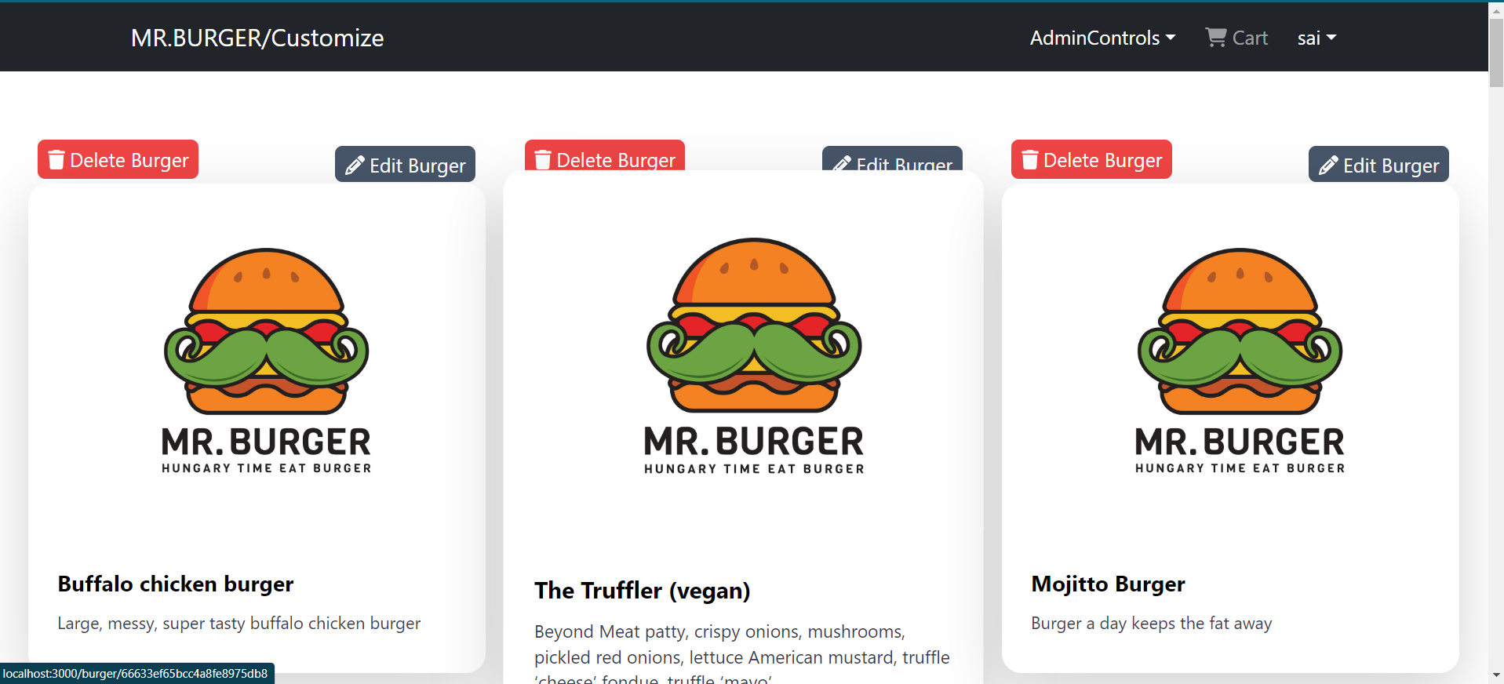
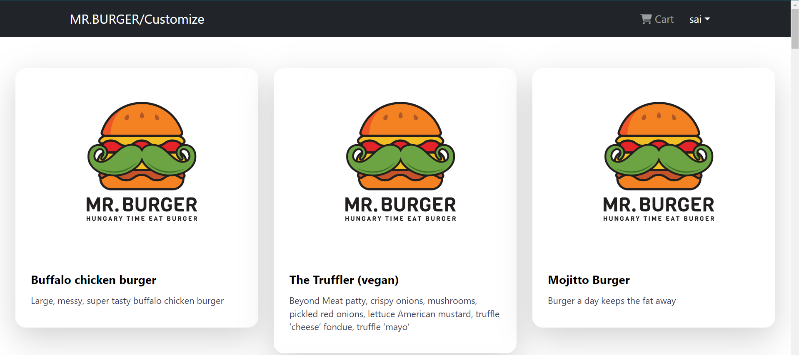
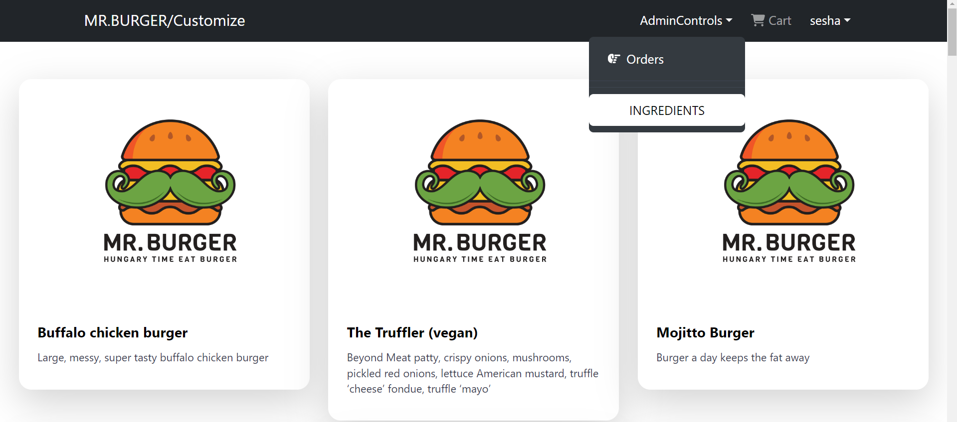
Welcome Page
Admin
Employee
user

Slide 7
Security and Access Control
Authentication: Sign-in required to access the cart and place orders.
Role-Based Access Control: Different functionalities based on user roles (users, employees, administrators).
Unauthorized Access Restrictions: Prevents unauthorized users from accessing restricted pages and functionalities.
EXCEL DATA
saving data in excel format

Slide 8
Thank You
-SAI ADUSUMILLI

